Slide 1

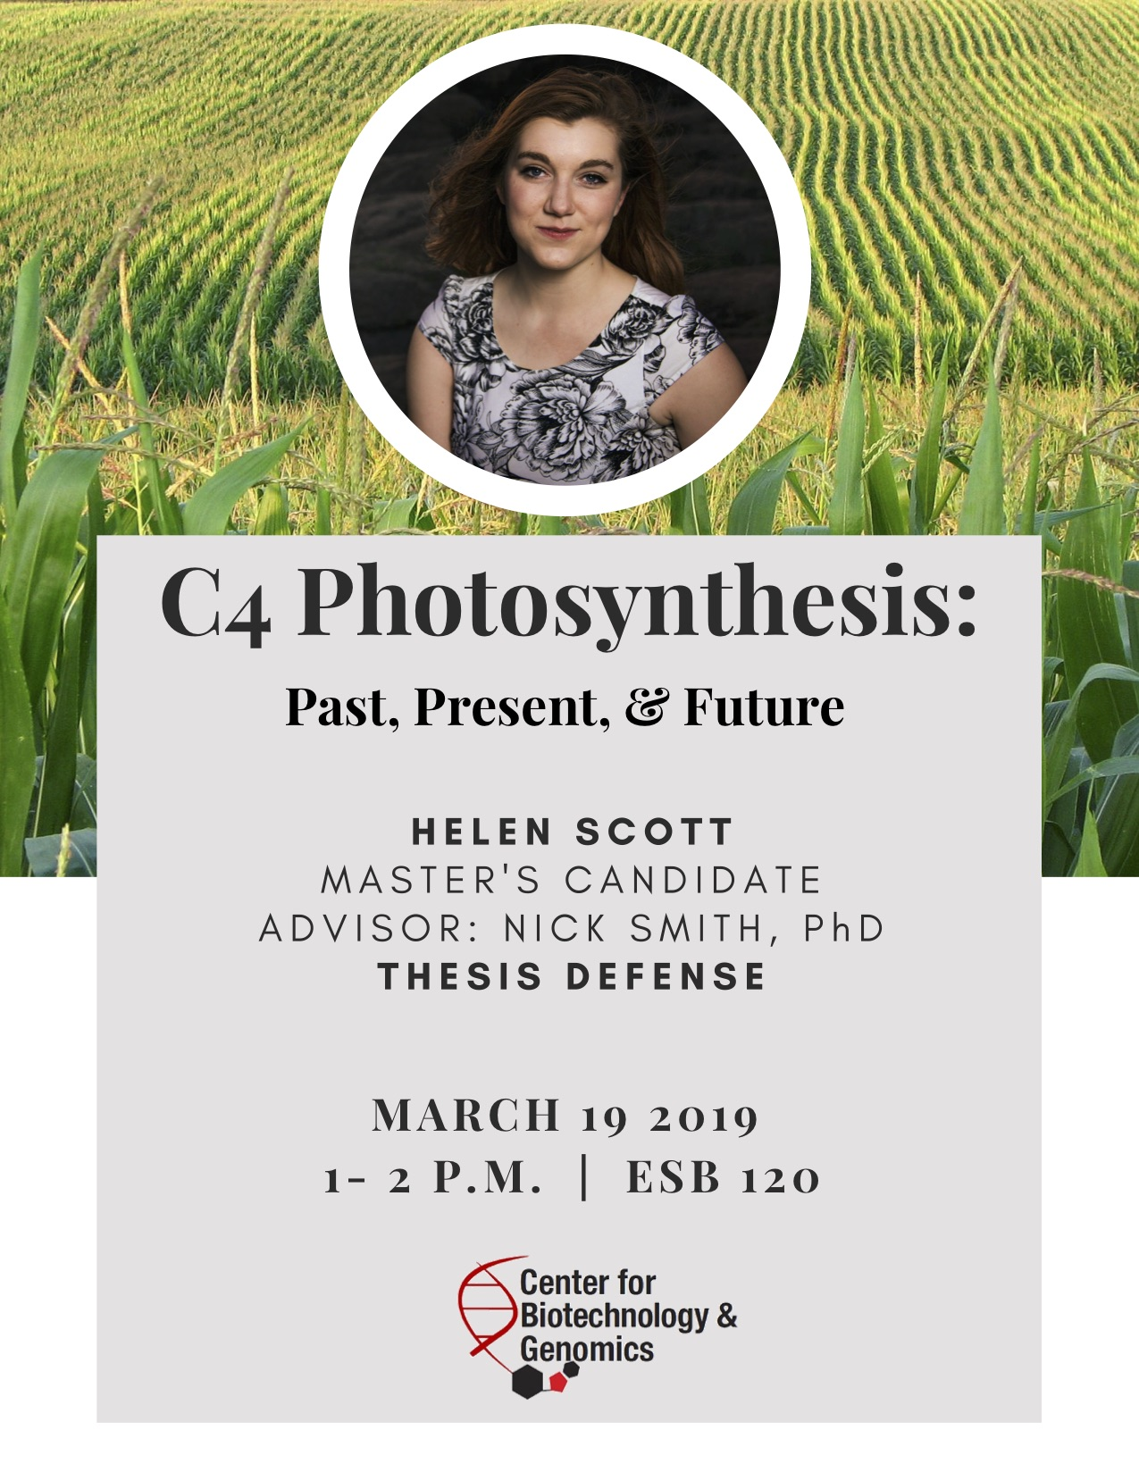
Photosynthetic acclimation through the lens of optimality
Nick Smith
Texas Tech University
nick.smith@ttu.edu; @nick_greg_smith
Lizz Waring
TTU
Helen Scott
TTU
Trevor Keenan
Berkeley Lab
Wang Han
NW A&F Univ.
Colin Prentice
Imperial College

Slide 2
Predicting photosynthesis is important!
nick.smith@ttu.edu; @nick_greg_smith

Slide 3
Predicting photosynthesis is important!
nick.smith@ttu.edu; @nick_greg_smith
Data from IPCC (2013)

Slide 4
Predicting photosynthesis is important!
nick.smith@ttu.edu; @nick_greg_smith
Photosynthesis
Data from IPCC (2013)

Slide 5
nick.smith@ttu.edu; @nick_greg_smith
But photosynthetic parameters are uncertain
Rogers (2012). Photosynthesis Res.

Slide 6
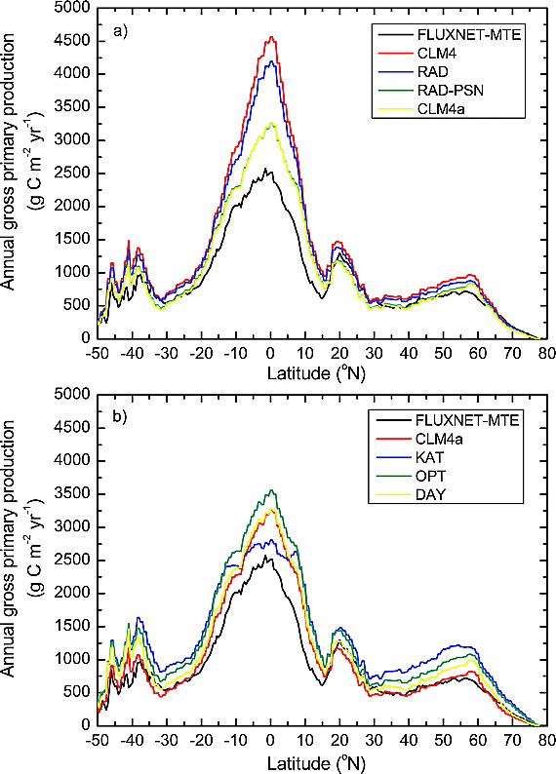
nick.smith@ttu.edu; @nick_greg_smith
Parameter uncertainty alters simulated global carbon uptake – indirectly influencing climate
Bonan et al. (2011). JGR-Biogeosciences.
Notes:
Zonal average annual GPP for (a) model structural error and (b) model parameter uncertainty in comparison with FLUXNET‐MTE. Figure 5a shows model structural error for simulations CLM4, RAD, RAD‐PSN, and CLM4a (RAD‐PSN‐KN). Figure 5b shows model parameter uncertainty for simulations KAT, OPT, and DAY in comparison with CLM4a.
IF THIS IMAGE HAS BEEN PROVIDED BY OR IS OWNED BY A THIRD PARTY, AS INDICATED IN THE CAPTION LINE, THEN FURTHER PERMISSION MAY BE NEEDED BEFORE ANY FURTHER USE. PLEASE CONTACT WILEY'S PERMISSIONS DEPARTMENT ON PERMISSIONS@WILEY.COM OR USE THE RIGHTSLINK SERVICE BY CLICKING ON THE 'REQUEST PERMISSIONS' LINK ACCOMPANYING THIS ARTICLE. WILEY OR AUTHOR OWNED IMAGES MAY BE USED FOR NON-COMMERCIAL PURPOSES, SUBJECT TO PROPER CITATION OF THE ARTICLE, AUTHOR, AND PUBLISHER.

Slide 7
Parameter uncertainty also directly influences climate through energy fluxes
nick.smith@ttu.edu; @nick_greg_smith
Higher photosynthesis
Shifts in global temps
Smith et al. (2017) JAMES
Notes:
Here I will walk you through the effects step by step. First, we found that acclimation increased future photosynthesis

Slide 8
Predicting photosynthesis is important! (and not trivial)
nick.smith@ttu.edu; @nick_greg_smith

Slide 9
What we know well: Short-term responses of photosynthesis
nick.smith@ttu.edu; @nick_greg_smith

Slide 10
What we know well: Short-term responses of photosynthesis
nick.smith@ttu.edu; @nick_greg_smith
Models reproduce these curves very well!

Slide 11
Long-term responses can differ from short-term responses due to acclimation
nick.smith@ttu.edu; @nick_greg_smith

Slide 12
Long-term responses can differ from short-term responses due to acclimation
nick.smith@ttu.edu; @nick_greg_smith
Acclimated to high light
Acclimated to low light

Slide 13
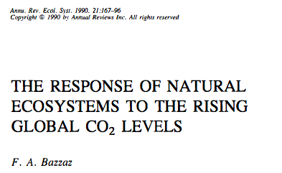
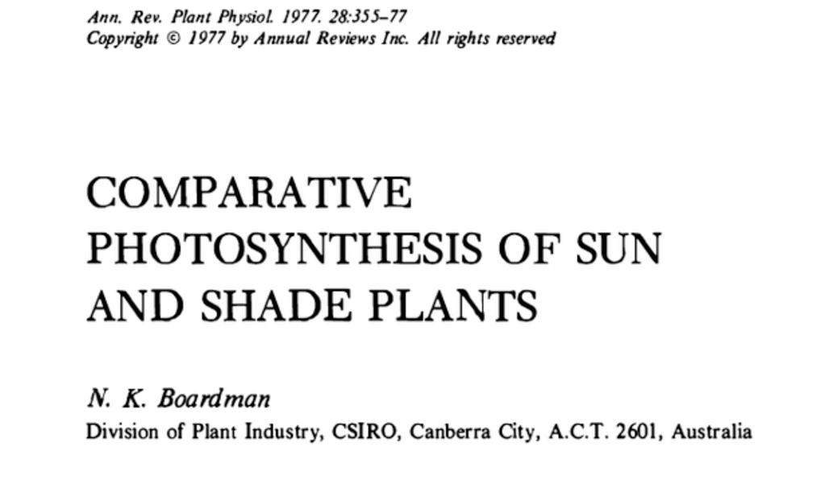
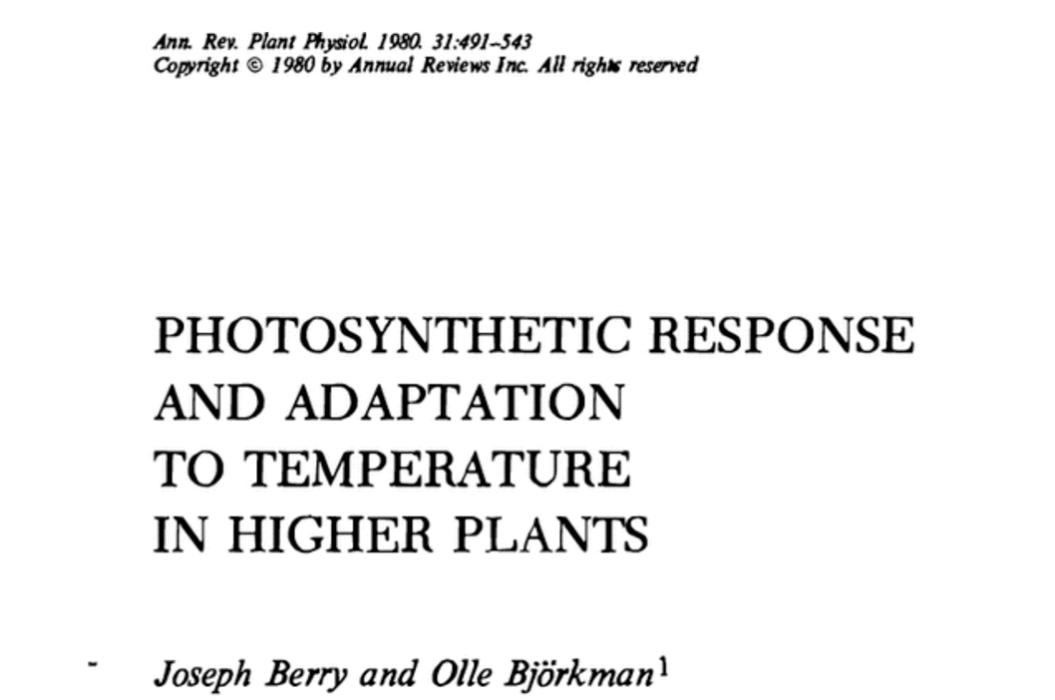
Acclimation is ubiquitous and well known…
nick.smith@ttu.edu; @nick_greg_smith
Temperature: Berry & Björkman (1980)
CO₂: Bazzaz (1990)
Light: Boardman (1977)

Slide 14
…but can we reliably model it?
nick.smith@ttu.edu; @nick_greg_smith

Slide 15
Modeling acclimation: the typical approach
nick.smith@ttu.edu; @nick_greg_smith
Measure plants following acclimation
Measure the change in response parameters to changes in conditions
Kattge and Knorr (2007) PC&E & many other studies (including my own)

Slide 16
Modeling acclimation: the typical approach
nick.smith@ttu.edu; @nick_greg_smith
Measure plants following acclimation
Measure the change in response parameters to changes in conditions

Slide 17
Modeling acclimation: the typical approach
nick.smith@ttu.edu; @nick_greg_smith
Measure plants following acclimation
Measure the change in response parameters to changes in conditions
Problems:
Leads to over-parameterization
Confounds multiple effects
Tuned to limited measurements

Slide 18
Our Approach: Step back and simplify
nick.smith@ttu.edu; @nick_greg_smith

Slide 19
Our Approach: Step back and simplify
nick.smith@ttu.edu; @nick_greg_smith
Goal
Predict acclimation responses without reliance on empirical parameters
Toolbox
Photosynthetic theory
Assumption
Given enough time, plants will acclimate to optimize biochemical processes to given condition

Slide 20
Optimization: Least cost hypothesis
Maintain highest amount of photosynthesis at the lowest cost (water and nutrient use)
Wright et al. (2003) American Naturalist

Slide 21
Optimal photosynthesis
Photosynthesis = f{stomatal conductance,
photosynthetic biochemistry}

Slide 22
Optimal photosynthesis
Photosynthesis = f{stomatal conductance,
photosynthetic biochemistry}
Must predict optimal rates of both

Slide 23
Optimal photosynthesis
Photosynthesis = f{stomatal conductance,
photosynthetic biochemistry}

Slide 24
Open stomata:
Benefits
High CO₂ influx
Costs
High water outflux
Closed stomata:
Benefits
Low water outflux
Costs
Low CO₂ influx

Slide 25
Open stomata:
Benefits
High CO₂ influx
Costs
High water outflux
Closed stomata:
Benefits
Low water outflux
Costs
Low CO₂ influx
Must maintain high amount of Rubisco to do photosynthesis

Slide 26
Stomatal openness determines χ
χ = internal leaf CO₂ / external leaf CO₂
χ = c_{i} / c_{a}

Slide 27
Optimal χ
Optimal χ maximizes photosynthesis at least water loss and nutrient use
Water loss is from transpiration
Nutrient use is nutrients used to maintain Rubisco
Rubisco proxy is V_{cmax}

Slide 28
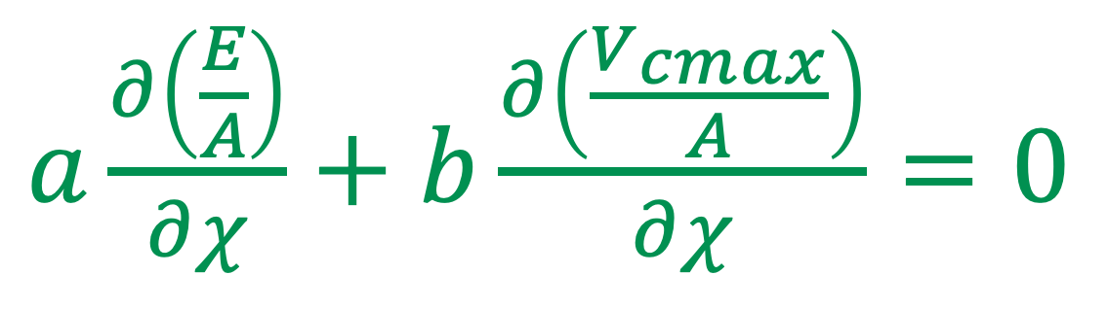
Optimal χ balances the costs to maintain transpiration and carboxylation
$a\frac{∂\left(\frac{E}{A}\right)}{∂χ}+$ $b\frac{∂\left(\frac{V_{cmax}}{A}\right)}{∂χ}=0$
Cost factor for transpiration (E)
Cost factor for
Rubisco (V_{cmax})

Slide 29
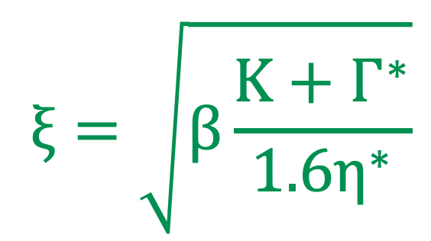
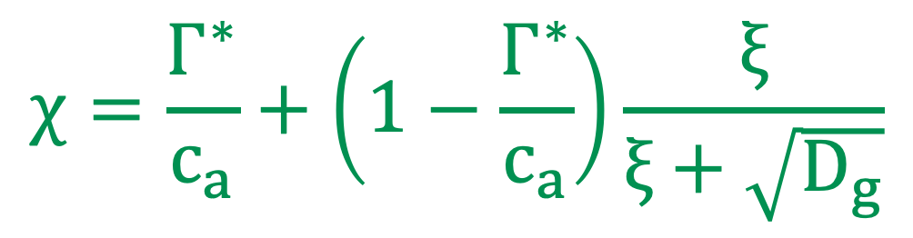
Optimal χ mathmatically
$$χ=\frac{Γ^{∗}}{c_{a}}+\left(1−\frac{Γ^{∗}}{c_{a}}\right)\frac{ξ}{ξ+\sqrt{D_{g}}}$$
$$ξ=\sqrt{β\frac{K+Γ^{∗}}{1.6η^{∗}}}$$

Slide 30
Optimal χ is a function of the costs and the environment
χ = f{a,
b,
temperature,
CO₂,
vapor pressure deficit}

Slide 31
Optimal χ is a function of the costs and the environment
χ = f{a,
b,
temperature,
CO₂,
vapor pressure deficit}
Empirically derived

Slide 32
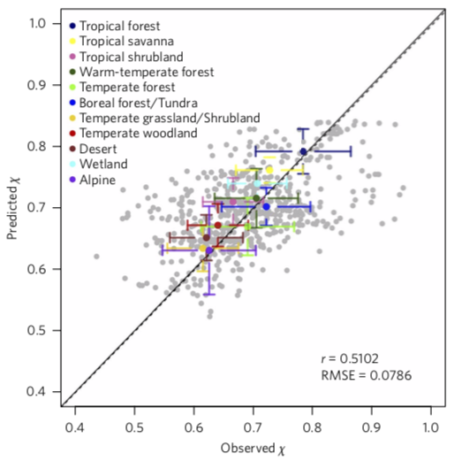
b/a = 146

Slide 33
Optimal χ is a function of the costs and the environment
χ = f{a,
b,
temperature,
CO₂,
vapor pressure deficit}
Environmental
variables

Slide 34
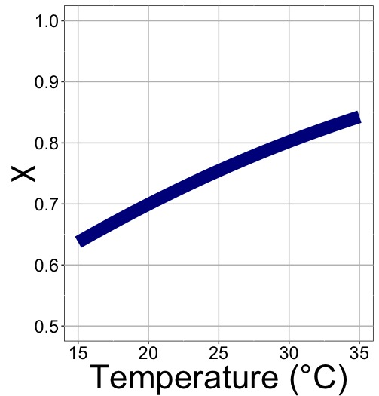
χ increases with temperature because of greater photorespiration

Slide 35
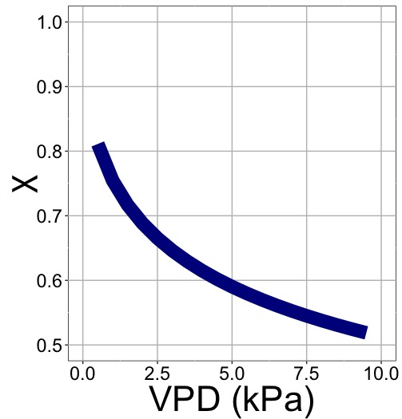
χ decreases with VPD because of greater water loss

Slide 36
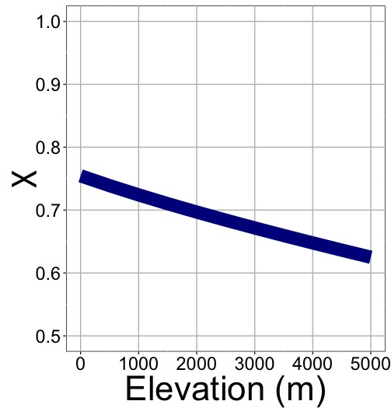
χ decreases with elevation because of greater VPD

Slide 37
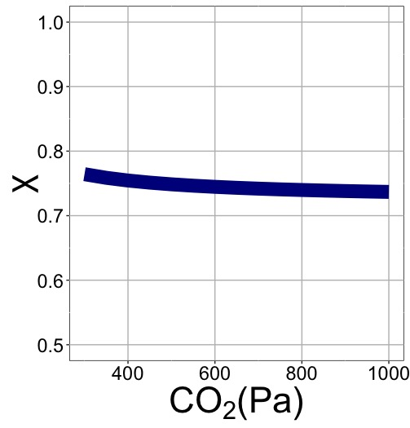
χ decreases with elevation because of lower openness needed to satisfy Rubisco

Slide 38
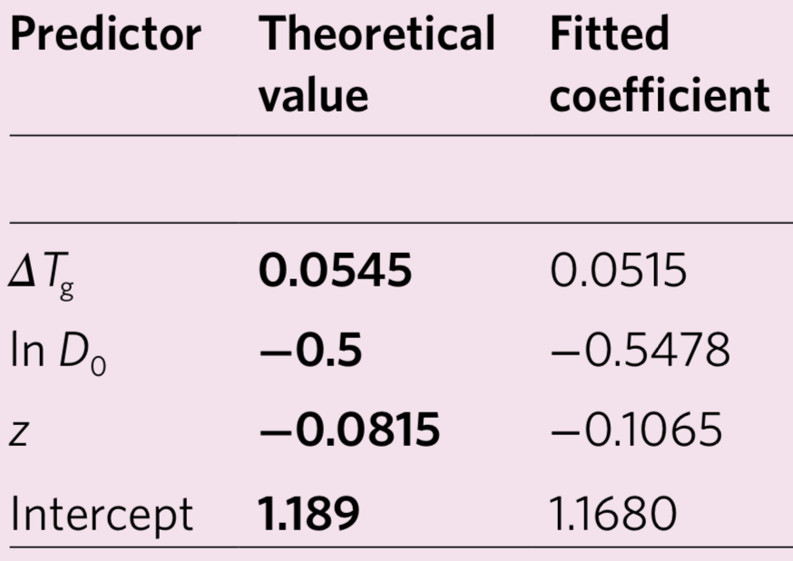
Globally, χ is optimized

Slide 39
Optimal photosynthesis
Photosynthesis = f{stomatal conductance,
photosynthetic biochemistry}

Slide 40
Biochemistry optimization: Coordination hypothesis
Under a given set of environmental conditions, photosynthesis may be limited by Rubisco carboxylation rate or electron transport rate to regenerate Rubisco
Optimally, plants will coordinate their biochemistry to be equally limited by both rates

Slide 41
Coordination of photosynthesis
nick.smith@ttu.edu; @nick_greg_smith
Optimally…
A_{c} = A_{j}
Electron transport-limited photosynthesis
Carboxylation-limited photosynthesis

Slide 42
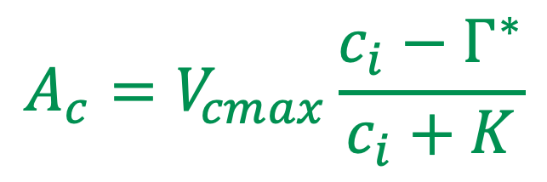
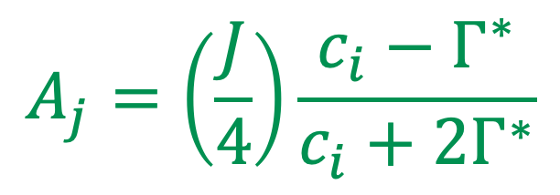
Coordination of photosynthesis
nick.smith@ttu.edu; @nick_greg_smith
$$A_{c}=V_{cmax}\frac{c_{i}−Γ^{∗}}{c_{i}+K}$$
Carboxylation-limited photosynthesis
$$A_{j}=\left(\frac{J}{4}\right)\frac{c_{i}−Γ^{∗}}{c_{i}+{2Γ}^{∗}}$$
Electron transport-limited photosynthesis
Farquhar, von Caemmer, & Berry (1980) Planta

Slide 43
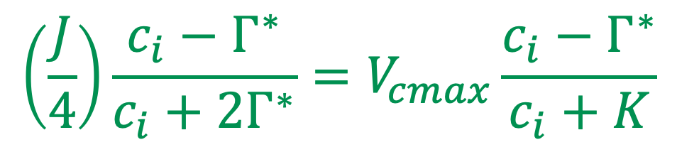

Coordination of photosynthesis
nick.smith@ttu.edu; @nick_greg_smith
$$A_{c}=A_{j}$$
$$\left(\frac{J}{4}\right)\frac{c_{i}−Γ^{∗}}{c_{i}+{2Γ}^{∗}}=V_{cmax}\frac{c_{i}−Γ^{∗}}{c_{i}+K}$$
Farquhar, von Caemmer, & Berry (1980) Planta

Slide 44
Rearrange to solve for measurable traits
nick.smith@ttu.edu; @nick_greg_smith
V_{cmax} = f {Φ_{psII}, light, T, c_{i}}
J_{max} = f {Φ_{psII}, light, T, c_{i}}
J_{max} /V_{cmax} = f {T, c_{i}}

Slide 45
Rearrange to solve for measurable traits
nick.smith@ttu.edu; @nick_greg_smith
V_{cmax} = f {Φ_{psII}, light, T, c_{i}}
J_{max} = f {Φ_{psII}, light, T, c_{i}}
J_{max} /V_{cmax} = f {T, c_{i}}
Empirically derived

Slide 46
Rearrange to solve for measurable traits
nick.smith@ttu.edu; @nick_greg_smith
V_{cmax} = f {Φ_{psII}, light, T, c_{i}}
J_{max} = f {Φ_{psII}, light, T, c_{i}}
J_{max} /V_{cmax} = f {T, c_{i}}
Environmental variables

Slide 47
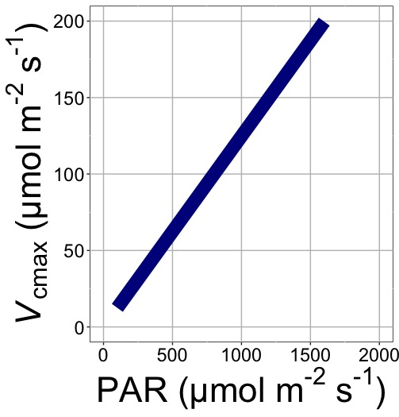
V_{cmax} increases with light because of greater electron transport

Slide 48
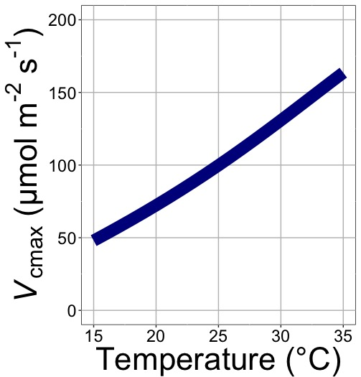
V_{cmax} increases with temperature because of greater electron transport and photorespiration

Slide 49
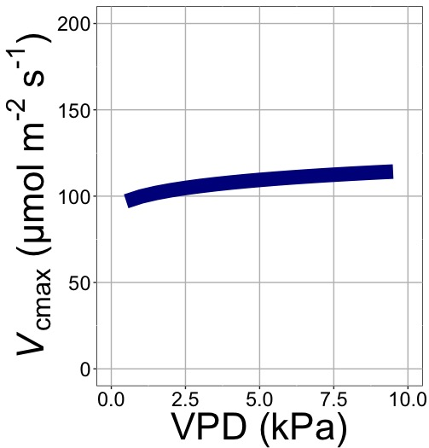
V_{cmax} increases with VPD because of lower stomatal conductance

Slide 50
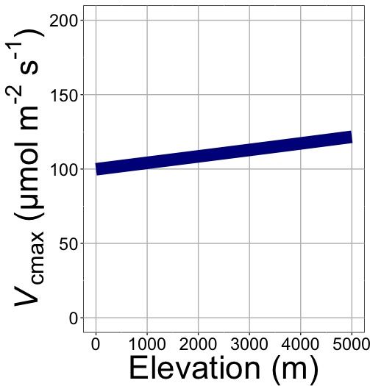
V_{cmax} increases with elevation because of lower stomatal conductance

Slide 51
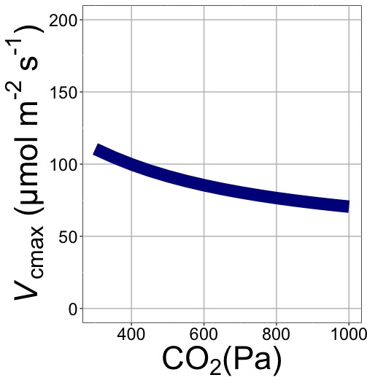
V_{cmax} decreases with CO₂ because of lower c_{i}

Slide 52
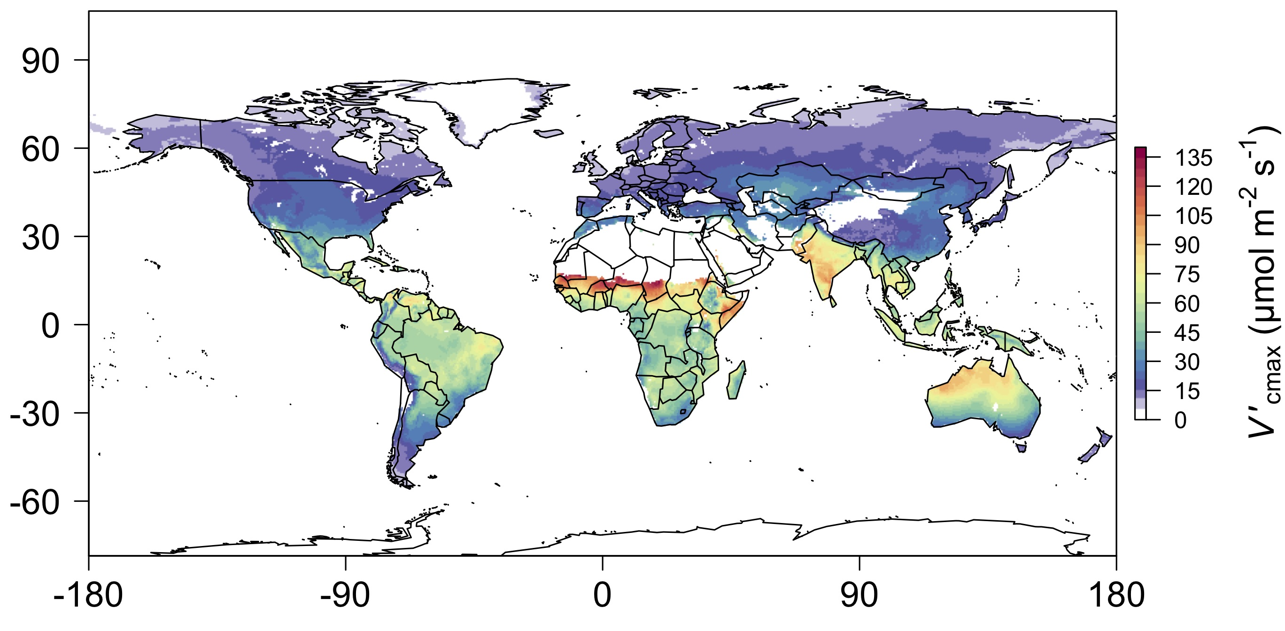
nick.smith@ttu.edu; @nick_greg_smith
We can predict optimal V_{cmax}
Smith et al. (2019)

Slide 53
Ok, great, but now what?

Slide 54
Let’s tackle some big questions in plant ecophysiology!

Slide 55
Question 1: Is photosynthesis optimized to the environment?

Slide 56
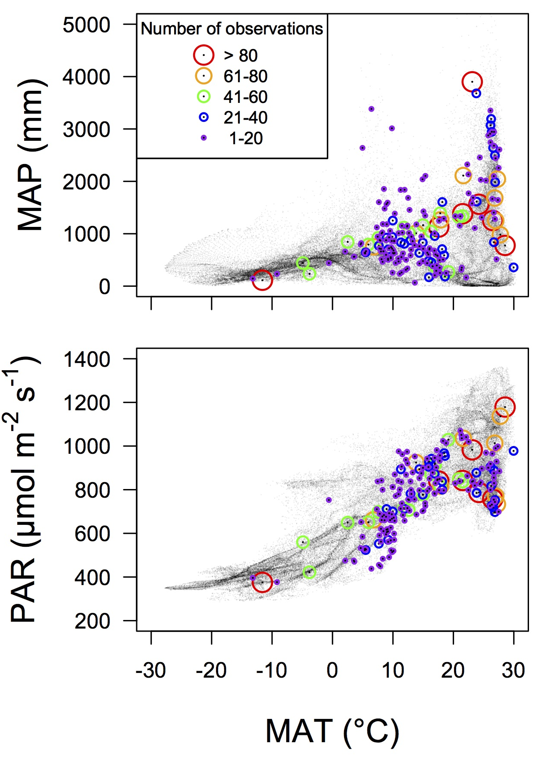
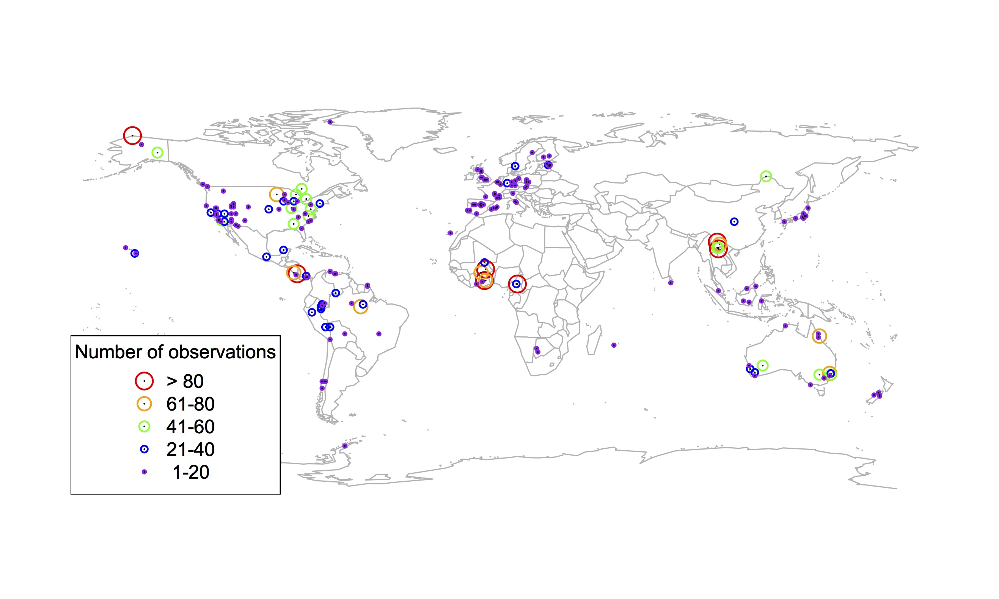
Global V_{cmax} dataset
nick.smith@ttu.edu; @nick_greg_smith
3,697 measurements
202 sites
> 600 genera
Smith et al. (2019)

Slide 57

nick.smith@ttu.edu; @nick_greg_smith
Smith et al. (2019)

Slide 58
Question 1: Is photosynthesis optimized to the environment? YES! Photosynthetic capacity acclimates spatially as expected from optimization

Slide 59
Question 2: How will photosynthesis acclimate to future conditions?

Slide 60
Photosynthetic traits change with temperature and CO₂ in ways expected from optimization
mean: -12%
mean: -15%

Slide 61
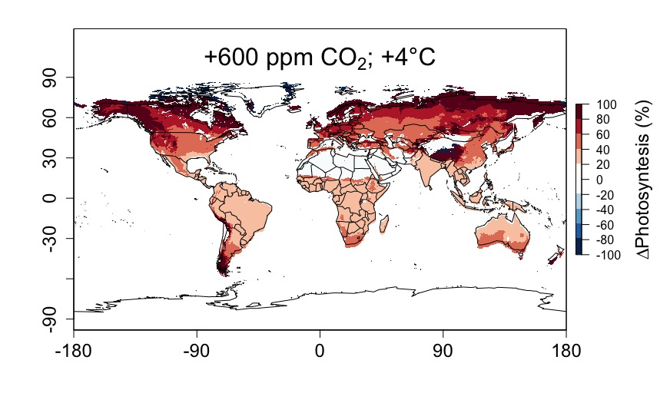
Higher CO₂ and increased temperatures increase future photosynthesis

Slide 62
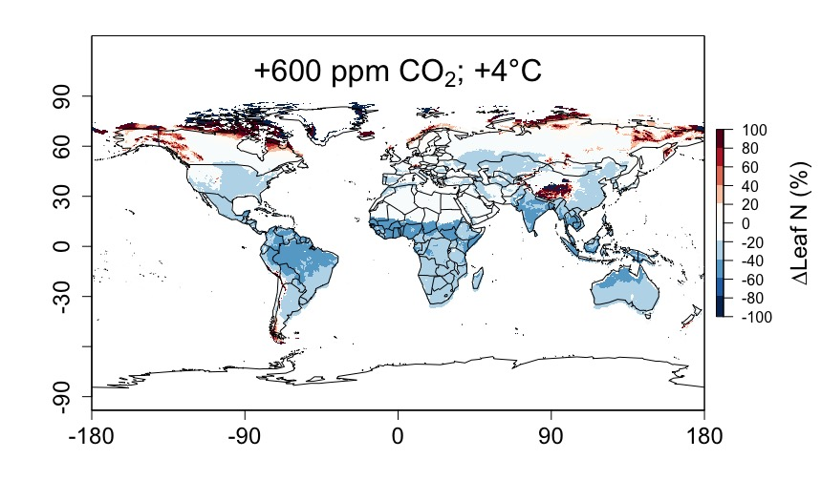
Higher CO₂ and increased temperatures increase future photosynthesis (at lower nutrient use)

Slide 63
Question 2: How will photosynthesis acclimate to future conditions? Higher temperatures → increased photosynthesis and allocation to carbon capture; Elevated CO₂ → increase photosynthesis, but less allocation to carbon capture

Slide 64
Question 3: Does photosynthesis respond to nutrient addition?

Slide 65
From the least cost hypothesis…
Assuming that Φ_{psII} is relatively static, added nutrients will not increase photosynthesis because light limitation will kick in
Optimal response would be to increase leaf area

Slide 66
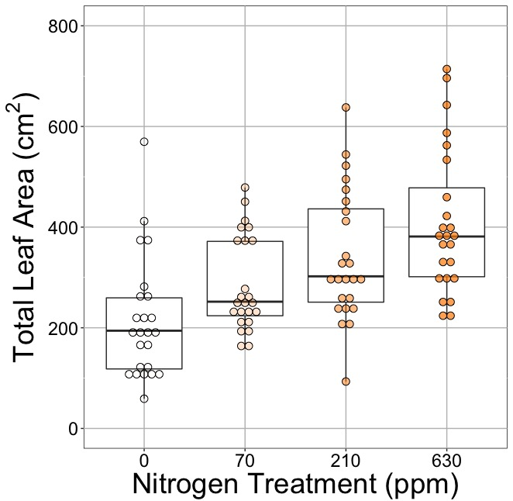
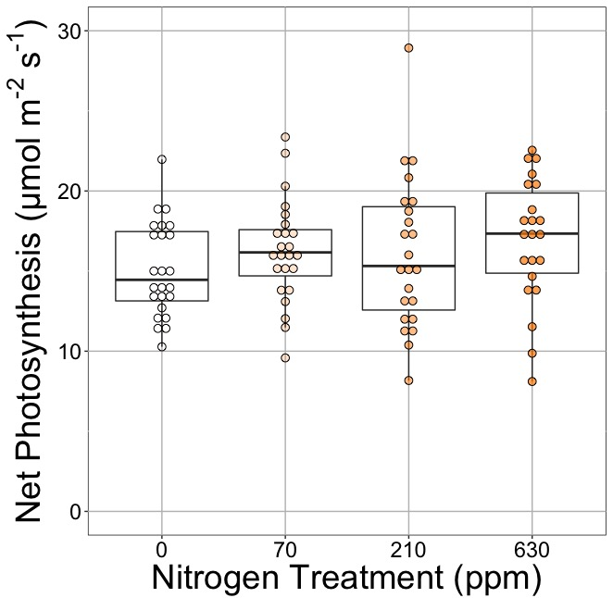
Leaf area, but not photosynthesis increases with N addition in a greenhouse experiment

Slide 67
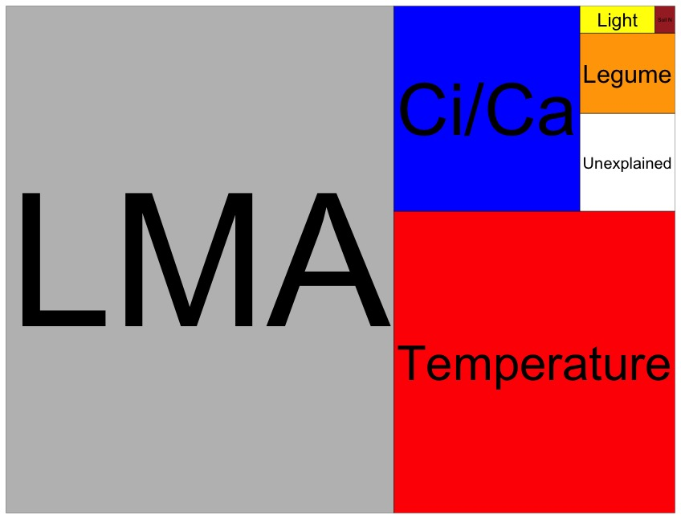
Across a global network of nutrient addition studies, nutrient addition does not explain leaf N
Each box is proportional to the variance in leaf N explained by each variable

Slide 68
Question 3: Does photosynthesis respond to nitrogen addition? No, plants respond to added nitrogen by increasing leaf area, not photosynthesis

Slide 69
Question 4: When is C₄ photosynthesis an advantage over C₃ photosynthesis?

Slide 70
C₃ versus C₄ optimization

Slide 71
C₄ versus C₃ optimization
C₄ photosynthesis has…
No photorespiration
An additional limitation (PEP carboxylation)

Slide 72
Red = C₄
Blue = C₃

Slide 73
Question 4: When is C₄ photosynthesis an advantage over C₃ photosynthesis? C₄ is better in hot, dry, high light, low CO₂ environments

Slide 74
Conclusion 1: Plants acclimate to environment to optimize carbon uptake capacity
nick.smith@ttu.edu; @nick_greg_smith
Dumb plants

Slide 75
Conclusion 2: We can now quantify acclimation theoretically
nick.smith@ttu.edu; @nick_greg_smith

Slide 76
Conclusion 2: We can now quantify acclimation theoretically
nick.smith@ttu.edu; @nick_greg_smith
Good for models
Reduced lines of code!
Reduced parameterization error!
Good for empirical research
A null model for empirical evaluation

Slide 77
Conclusion 2: We can now quantify acclimation theoretically
nick.smith@ttu.edu; @nick_greg_smith
Good for models
Reduced lines of code!
Reduced parameterization error!
Good for empirical research
A null model for empirical evaluation of multiple effects

Slide 78
Conclusion 3: Results of model testing suggest
nick.smith@ttu.edu; @nick_greg_smith
Per leaf area photosynthesis will increase with future warming and elevated CO₂
Future per leaf area nutrient use will decrease
Leaves do not respond to nitrogen addition

Slide 79
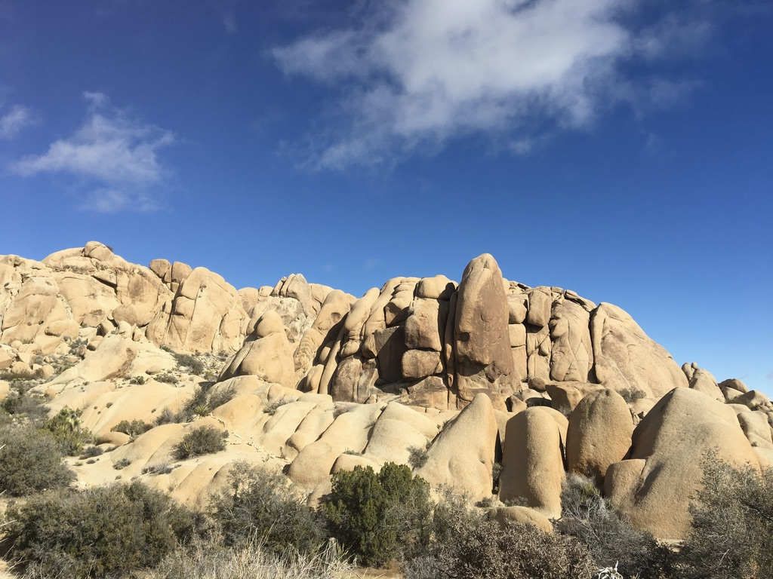
nick.smith@ttu.edu; @nick_greg_smith
Thanks!

